Slide 1
Magenic Masters React Quiz
Feb 2, 2017
Mily Opena

Slide 2


Bug – Missing CSS

Slide 3
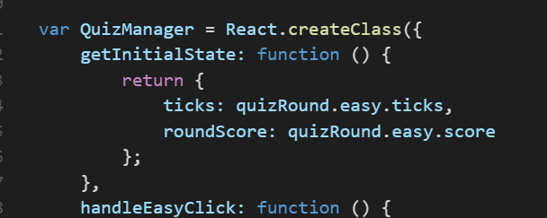

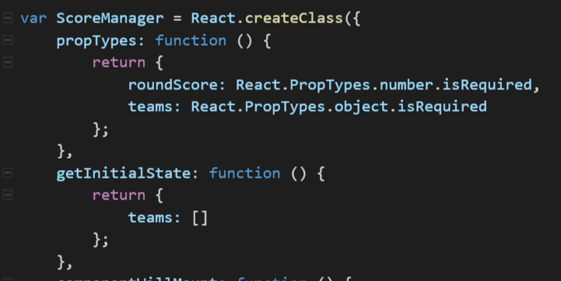
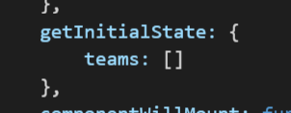
Bug - GetInitialState

Slide 4


Bug - PropTypes

Slide 5

Bug – no module.exports

Slide 6
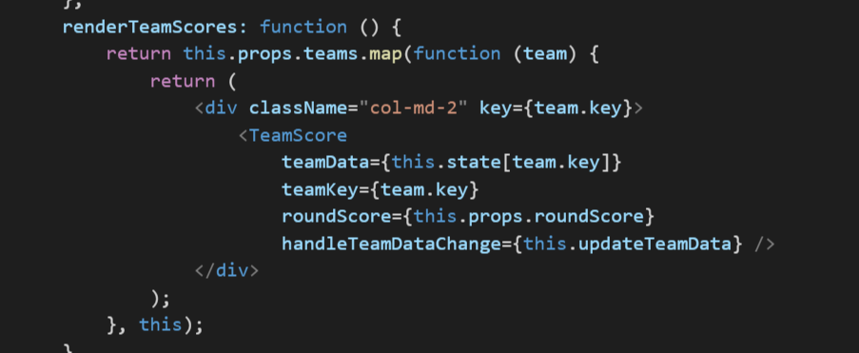
Bug – no current context on map function

Slide 7

Bug – componentShouldUpdate in ScoreManager

Slide 8

Bug – invoked event handler

Slide 9

Bug – no props on event callback

Slide 10
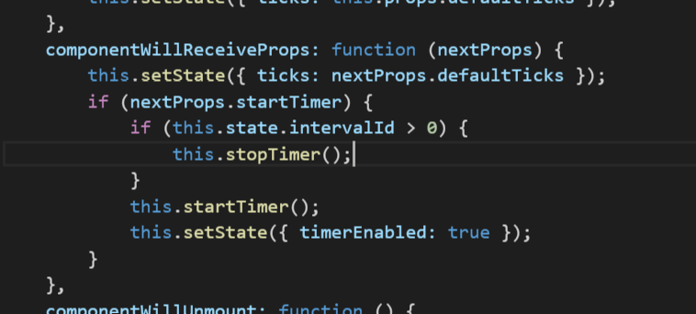
Bug – missing nextProps

Slide 11


Bug – missing target element

Slide 12

Bug – return in render

Slide 13

Bug – events in lowercase

Slide 14
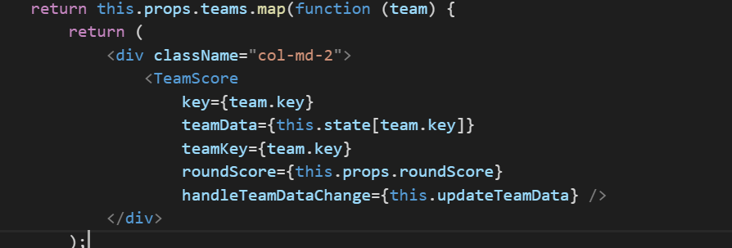
Bug – key inside child element

Slide 15

Bug – missing this context

Slide 16
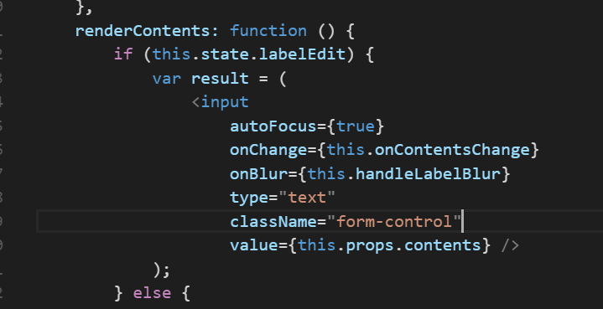
Bug – missing return

Slide 17


Bug – componentWillUpdate

Slide 18
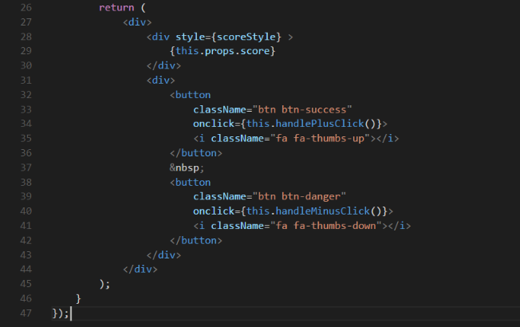
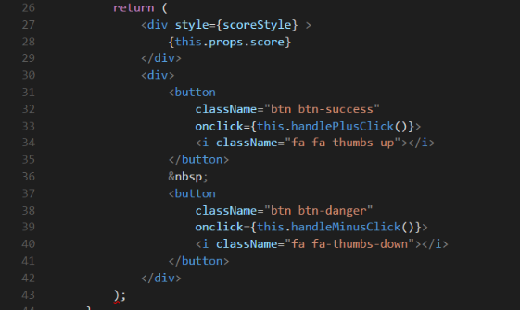
Bug – multiple root element

Slide 19


Bug – React missing

Slide 20


Bug – non usage of this.setState()

Slide 21
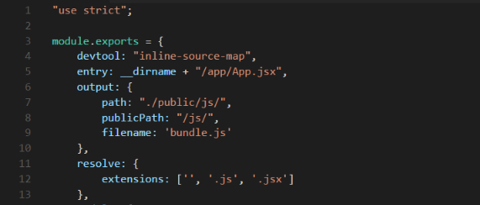
Bug – no entry in webpack.config.js

